Slide 1
AI-Powered Route Recommendations Web Application based on Extreme Weather Conditions and Green Gas Emissions
Mahdi Mohammadizadeh, Hadi Aghazadeh
Geomatics Engineering, Schulich School of Engineering
March-16-2023

Slide 2

Agenda
Why route recommendations?
Why extreme weather?
Why green gas emissions?
How can AI help?
Final project overview
Data and data flow
Web application modules
Notes:
In this presentation, we're going to talk about our project, which is a route recommendations app based on extreme weather and gas emissions. We'll dive into why route recommendations are so important, why considering extreme weather is crucial, and the impact of greenhouse gas emissions on the environment.
Then we'll get into how AI can help us tackle these challenges, with examples of how AI-powered tools and technologies can improve our decision-making and help us navigate unpredictable weather conditions.
We'll also give you an overview of our final project, including the role that data and data flow play in its success. And finally, we'll talk about our web application modules that we've developed to present the project's results and make recommendations based on users’ main criteria.

Slide 3
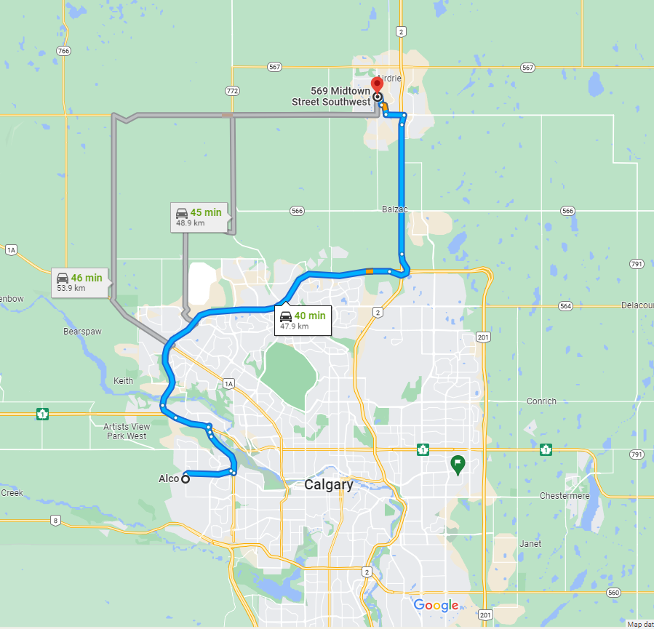
Why Route Recommendations?
The goal is not always the shortest route
The goal of Route Recommendation Systems is to personalize and recommend routes based on Subjective Goals, not Objective ones.
What are your goals?
“Even if I were certain I was going to heaven, I would pray God to let me go by the longest possible route.” ~ Nikos Kazantzakis
Notes:
So, Route Recommendation Systems are like a GPS that helps us find the best route to reach our destination, but it's not just about finding the shortest route. It's about personalizing the route recommendation based on our subjective goals. As Nikos Kazantzakis said, sometimes we want to take the longest possible route just to enjoy the journey.
So, when we travel from Calgary to Airdrie, we may have different objectives such as avoiding certain roads, taking a scenic route or reaching our destination quickly. And that's where a personalized approach to route recommendation comes in. By considering our subjective goals before seeking recommendations, we can provide the system with the necessary information to ensure that our goals are taken into account when suggesting a route.

Slide 4
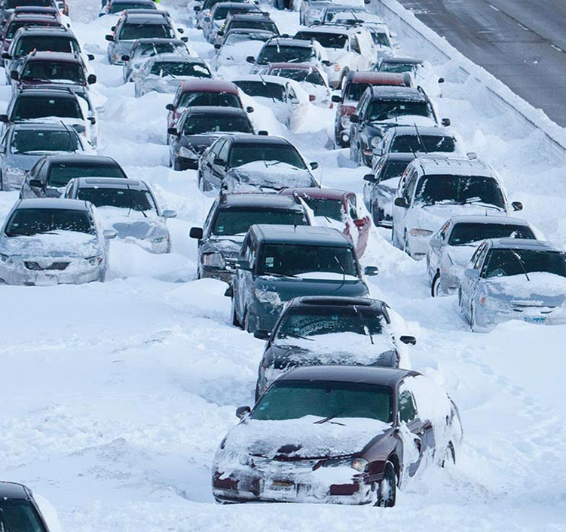
Why Extreme Weather?
Extreme weather can affect Canada's roadways by:
Heavy snowfall and ice storms
Freezing rain
According to a study by the National Research Council Canada, winter road maintenance costs across Canada are estimated to be between $3 billion and $5 billion annually.
In 2020, Alberta province experienced a significant snowstorm that closed major highways, including the Trans-Canada Highway and caused widespread travel disruptions. The storm resulted in multiple car accidents and stranded travelers.
According to a report by the University of Waterloo and the Intact Centre on Climate Adaptation, climate change is expected to increase the frequency and severity of extreme weather events in Alberta, which will likely have significant impacts on the province's transportation system.
In 2018, a major hailstorm hit the Calgary area, causing significant damage to vehicles, which led to travel disruptions and increased traffic congestion on roadways.
Notes:
So, have you ever been stuck in a snowstorm or an ice storm while driving? It's not a pleasant experience, right? Well, extreme weather conditions can have a significant impact on Canada's roadways, and it's not just about the inconvenience of being stuck in traffic. Heavy snowfall, ice storms, and freezing rain can lead to car accidents and widespread travel disruptions.
According to a study by the National Research Council of Canada, winter road maintenance costs across Canada range between $3 billion and $5 billion annually. That's a lot of money! In 2020, Alberta province experienced a severe snowstorm that caused major highways to close down, resulting in multiple car accidents.
Unfortunately, climate change is likely to increase the frequency and severity of extreme weather events in Alberta, which could have significant impacts on the province's transportation system. A report by the University of Waterloo and the Intact Centre on Climate Adaptation warns that these events will become more common, and we need to prepare ourselves to face them.
In 2018, a major hailstorm hit the Calgary area, causing significant damage to vehicles and leading to travel disruptions and increased traffic congestion on roadways. Overall, extreme weather conditions in Canada can have serious consequences on the transportation system, affecting travel safety, infrastructure, and maintenance costs. So, it's essential to keep an eye on the weather and prepare accordingly to stay safe on the road.

Slide 5
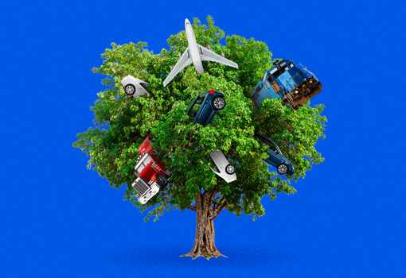

Why green gas emissions?
The transportation sector is a significant contributor to greenhouse gas emissions in Canada, accounting for approximately 25% of the country's total emissions in 2019, according to Environment and Climate Change Canada.
the transportation sector was responsible for 174 megatons of CO2 equivalent emissions, which was a slight increase from the previous year. (Source: Environment and Climate Change Canada)
The average emissions intensity of passenger vehicles in Canada was 188 grams of CO2 per kilometer in 2019, which was a slight decrease from the previous year. However, this is still significantly higher than the emissions standards set by the Canadian government for 2025. (Source: Environment and Climate Change Canada)
Canada has set a target to reduce its greenhouse gas emissions by 30% below 2005 levels by 2030. The transportation sector will need to make significant emissions reductions in order to meet this target. (Source: Government of Canada)
Notes:
Did you know that the transportation sector is responsible for about a quarter of Canada's greenhouse gas emissions? According to Environment and Climate Change Canada, it accounted for 174 megatons of CO2 equivalent emissions in 2019 alone.
To make things worse, the average emissions intensity of passenger vehicles in Canada is still way higher than the government's emissions standards for 2025. However, there is some good news: these emissions have decreased slightly since last year.
But Canada has set an ambitious target to reduce its greenhouse gas emissions by 30% below 2005 levels by 2030. This means the transportation sector will need to make some significant emissions reductions to help achieve this goal.
To make a real difference, we need to encourage the use of low-emission vehicles and roads which is our project goal and invest in public transportation infrastructure.

Slide 6
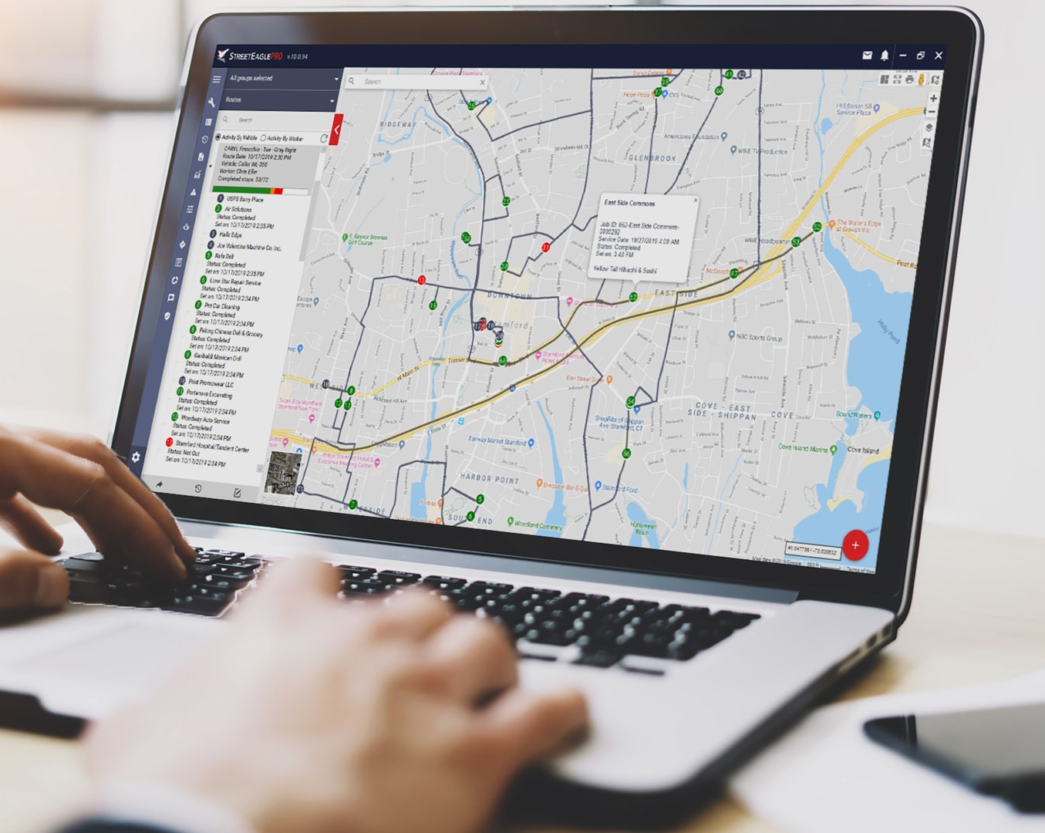
How can AI help in route recommendation?
AI can play a significant role in route recommendation systems by providing personalized and efficient route suggestions to users. Here are some ways AI can contribute:
AI can analyze vast amounts of data from various sources such as traffic data, weather data, historical data, and user preferences to determine the best routes for different users.
AI can use machine learning algorithms to learn from user behavior and preferences to provide personalized route recommendations. For instance, if a user frequently takes a particular route, AI can recommend it as their preferred route.
AI can use real-time data from various sources to adjust route recommendations based on changing conditions. For example, if there is heavy traffic on a particular road, AI can recommend an alternative route.
AI can use predictive analytics to anticipate user needs and provide proactive route recommendations. For example, if a user is traveling to a new city, AI can recommend the best routes and modes of transportation based on the user's profile and past travel behavior.
Notes:
You know what's really cool? AI can help us get around more efficiently with personalized route recommendations! Here are some ways it works:
Firstly, AI can analyze a ton of different data sources like traffic data, weather data, and user preferences to figure out the best routes for each user. It's like having a personal traffic expert on hand!
But it gets even better. AI can learn from each user's behavior and preferences, so it can make personalized route recommendations based on what you like. If you always take a certain route to work, AI can remember that and suggest it as your go-to route.
And if things change on the fly, like if there's heavy traffic or construction, AI can adjust your route recommendations in real-time to help you avoid any problems. It's like having a GPS that's always on the lookout for the fastest and most efficient way to get you where you're going.
Lastly, AI can even anticipate your needs and suggest the best routes and modes of transportation based on your profile and past travel behavior. So, if you're heading to a new city, AI can recommend the best way to get around based on what it knows about you. It's like having a personal travel agent!

Slide 7

Final Project Overview
The goal is to build a web application that:
Users choose the origin and destiny of a truck
There are three goal-based options for users to choose from - each rated from 0 to 10 :
Distance
Extreme Weather
Gas Emissions
The user adjusts the wights for three options and chooses the desired combination
The AI model, based on the chosen combination, shows all possible routes and selects the best suitable one with different colors
If the user changes their mind, and readjusts the weights, the model will respond dynamically in real-time and recommend the new route
Notes:
Imagine a web application that simplifies the process of selecting the best route for your trucking needs. We're building a super cool web app that'll help you plan truck routes like a pro. Here's how it works:
First, you pick the starting point and destination for your truck. Easy peasy.
Next, we've got three different options for you to choose from when it comes to your goals: distance, extreme weather, and gas emissions. You rate each option from 0 to 10, depending on how important it is to you.
Then, you get to play around with the weights for each of these options until you find the perfect combination that suits your needs. It's like customizing your own truck route!
Once you've found your ideal combination, our AI model will go to work and show you all of the possible routes. We color-code them to make it easy to see which one is the best fit for your needs.
And if you ever change your mind or need to make adjustments, don't worry! Our model is dynamic and will respond in real-time to your new preferences, recommending the best route all over again. How cool is that?

Slide 8
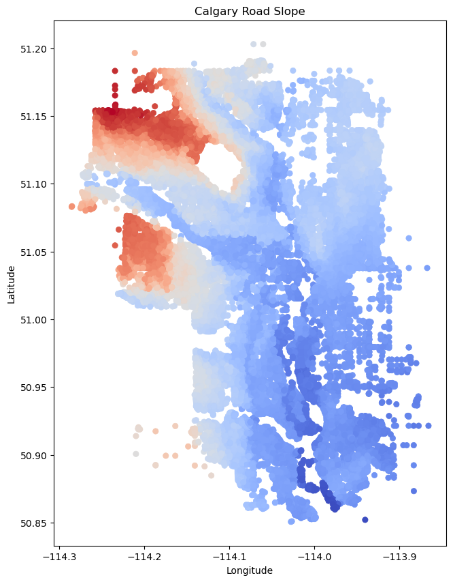
Calgary road Slope distribution

Slide 9
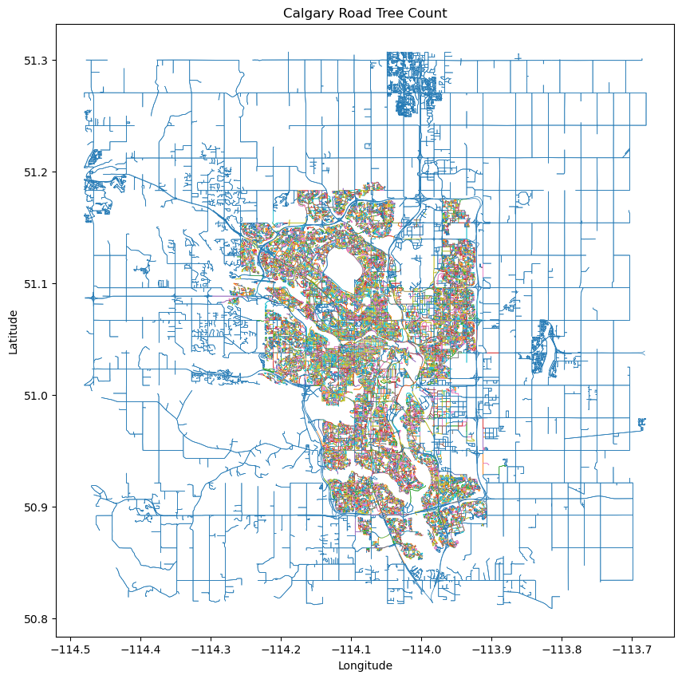
Calgary Tree Count Distribution

Slide 10
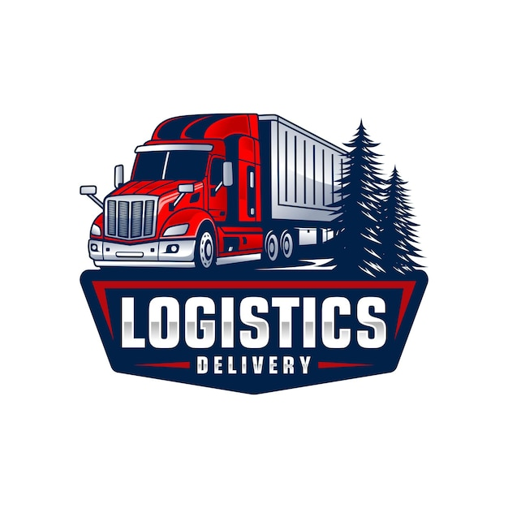
Web Application Modules
Routing Algorithm:
Trained Deep Reinforcement Learning
Reward: Weighted vectors of distance, extreme weather, and gas emissions
Action Space: different routes or paths that the user can take to reach their destination
State Space: user's current location, destination, time of day, weather conditions, gas emission level
Database:
MySQL
Map Modules:
MapBox
Leaflet.js
Frontend:
React
Backend:
Django (Python)
Material UI
Other Technologies:
Docker
Git
RESTful API
Notes:
So, we have a web application that has a few different modules working together to provide users with the best possible routing options.
One of the key components of this app is the routing algorithm, which is actually trained using deep reinforcement learning. Essentially, this means that the algorithm has been "taught" how to make decisions based on a set of weighted vectors that take into account things like distance, extreme weather, and gas emissions.
When a user inputs their desired destination, the algorithm uses this information along with the user's current location, time of day, and weather conditions to generate different route options for the user to choose from.
In order to power this app, we're also using a few different technologies. Our database is MySQL, and we're using Mapbox and leaflet.js for our map modules. On the frontend, we're using React and Material UI, while on the backend, we're using Django (which is a Python web framework) and a RESTful API.
Lastly, we're using a few other technologies to help us manage our codebase and deploy our app, including Git and Docker. Overall, all of these different pieces come together to create a robust web application that can help users find the best possible route to their destination based on a variety of different factors.

Slide 11

Data and Data Flow
For this project, we use Calgary map data
The main roads that trucks are allowed to go are the feasible actions spaces of the RL model
The data flow is static, however, the recommended routes change dynamically according to the user preferences
Several map layers like road slope, probability of extreme weather, percentage of gas emissions, etc. are used to feed to the model as a state space of the RL model
Notes:
Alright, let’s talk a little bit about the data and data flow in our application- we're using some seriously cool stuff for our project.
First off, we're using map data from Calgary to create our truck routes. It's gonna be legit.
But here's where things get really interesting - we're using a reinforcement learning (RL) model to determine which main roads are feasible for trucks to use. This means that the model learns over time which roads are best to take based on past experience. It's like having a smart, intuitive GPS system for truck routes.
Even though the data flow is static, our recommended routes change dynamically based on what you want. We've got several map layers that feed into the RL model, like road slope, probability of extreme weather, percentage of gas emissions, and more. All of this data creates a state space for the model to work with.
And the best part? All of this fancy tech is gonna make your truck routes way more efficient and customized to your needs. Can't wait to show you how it all works!

Slide 12


